Slide 1
LECTURE TWO
INTRODUCTION TO INFORMATION THEORY & THE INFORMATION WAR
ROBERT MELASHENKO MD
COPYRIGHT 2013 ROBERT MELASHENKO
ALL RIGHTS RESERVED

Slide 2
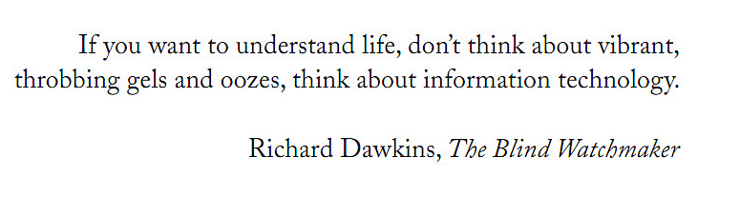

Slide 3
“The essence of the universe is information, so this line of thinking goes, and the fundamental bits of information that give rise to the universe live on the Plank scale. ‘Information means distinctions between things,’ explained Leonard Susskind during a lecture at the New York University last summer. ‘It is a very basic principle of physics that distinctions never disappear. They might get scrambled or all mixed up, but they never go away’”
Scientific American Feb 2012, page 35

Slide 4

Smallest to Biggest

Slide 5
INFORMATION THEORY
Information ”bits “ (basic unit of information) are the fundamental building blocks of the universe.
“I believe that spacetime is what we call ‘emergent’, says Herman Verlinde, a physicist at Princeton University and a former student of t’Hooft. ‘It will come out of a bunch of 0’s and 1’s.” Scientific American, February 2012, page 35.
Energy and matter are vehicles that carry information.
There is no place in the universe that is “information free” (Possible exception BH).
Information provides the basis for everything including the human body. (Leicester Press Office July 30, 2013)

Slide 6

BBC Order & Disorder

Slide 7
Each atom in your body is replaced every 7 years.
Within each nerve cell the molecules are replaced approximately 10,000 times in a life span. Yet, “you” remain “you” throughout the transitions.
Therefore, what determines “you”, is not the matter, but the “blueprint” that determines how the matter is arranged.

Slide 8
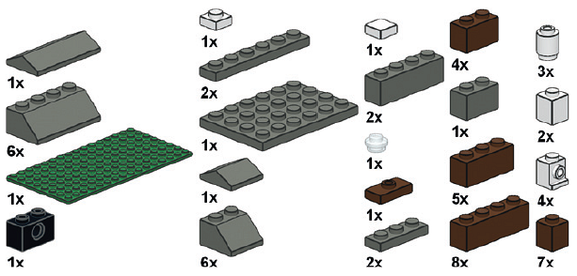
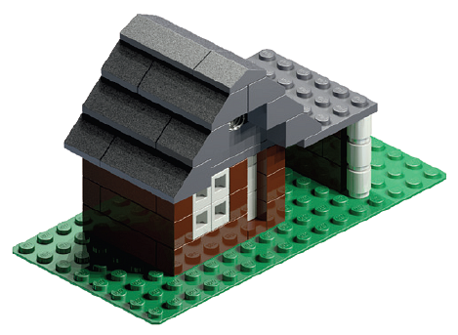

Slide 9
Informational “blueprint” for human beings = Genome
Most complex and incredibly powerful information system known

Slide 10
THE WAR

Slide 11
Why, as by one man sin entered into the world, and death by sin; and so death passed on all men, for that all have sinned:
(Romans 5:12 AKJV)
Nevertheless death reigned from Adam to Moses, even over them that had not sinned after the similitude of Adam's transgression, who is the figure of him that was to come.
(Romans 5:14 AKJV)

Slide 12
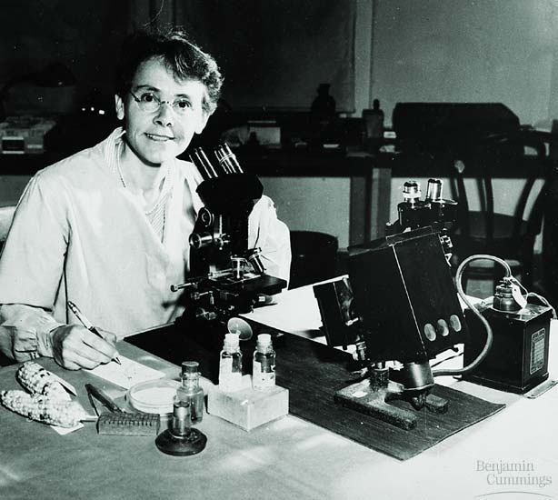
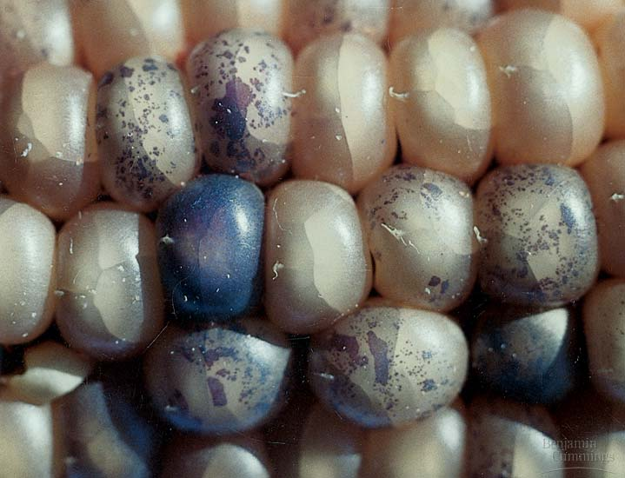
Barbara McClintock discovered that segments of DNA called transposons can move about within a cell’s genome
Figure 12.13B, C

Slide 13
Originally this DNA was called “Junk DNA”, or “Silent DNA”. Today there a number of names for this DNA, in this lecture we will use:
TRANSPOSABLE ELEMENTS (TE’s)

Slide 14
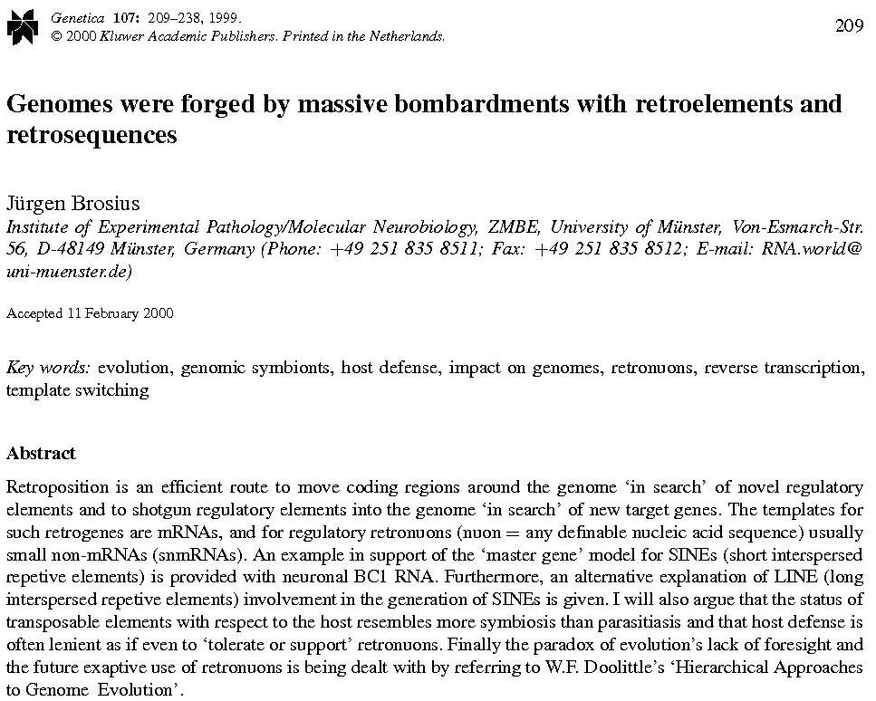

Slide 15
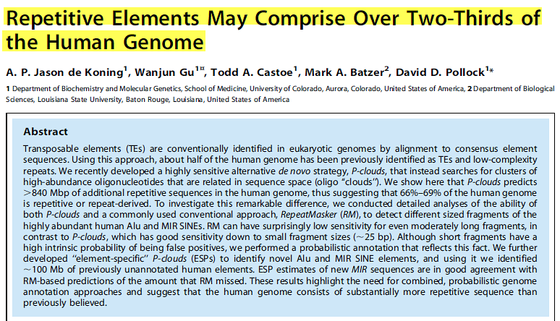
PLoS Genetics | 1 December 2011 | Volume 7 | Issue 12

Slide 16
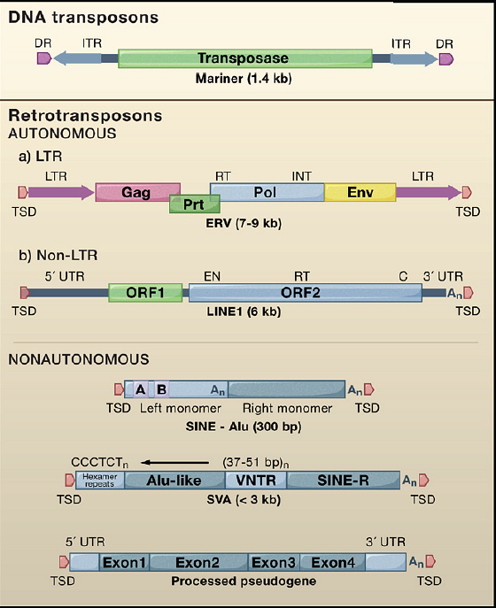
Retrotransposons Revisited: The Restraint and Rehabilitation of Parasites
John L. Goodier , Haig H. Kazazian Jr.
Figure 1 Types of Transposable Elements in Mammals Mariner-like DNA transposons are inactive relics in mammalian genomes. Retrotransposons that contain many, but not all, of the activities necessary for their mobility are called autonomous.
Cell Volume 135, Issue 1 2008 23 - 35

Slide 17
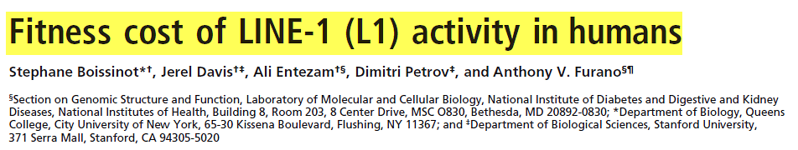
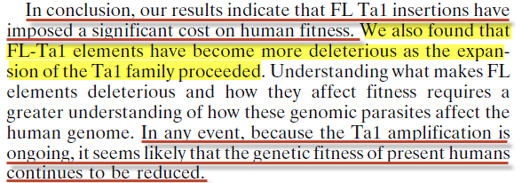
PNAS June 20, 2006 vol. 103 no. 25 9591

Slide 18
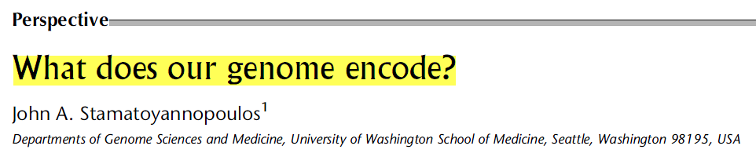
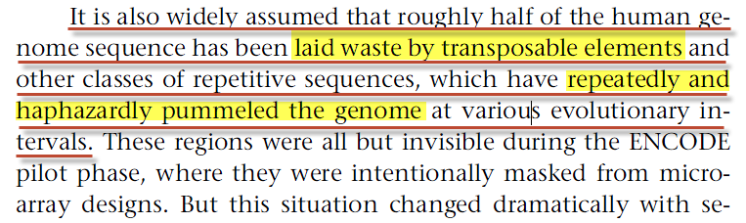
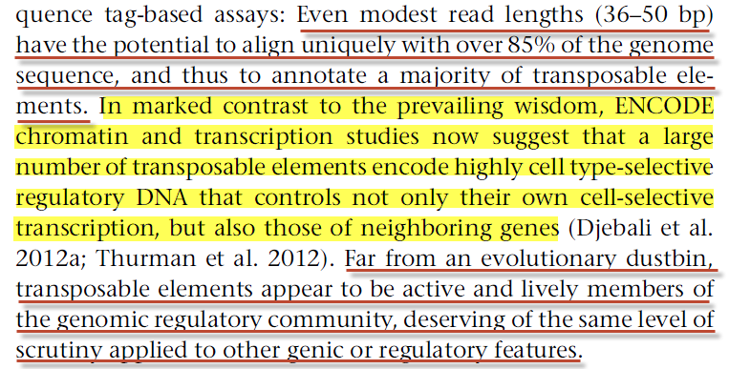
Genome Research 2012 22: 1602-1611

Slide 19
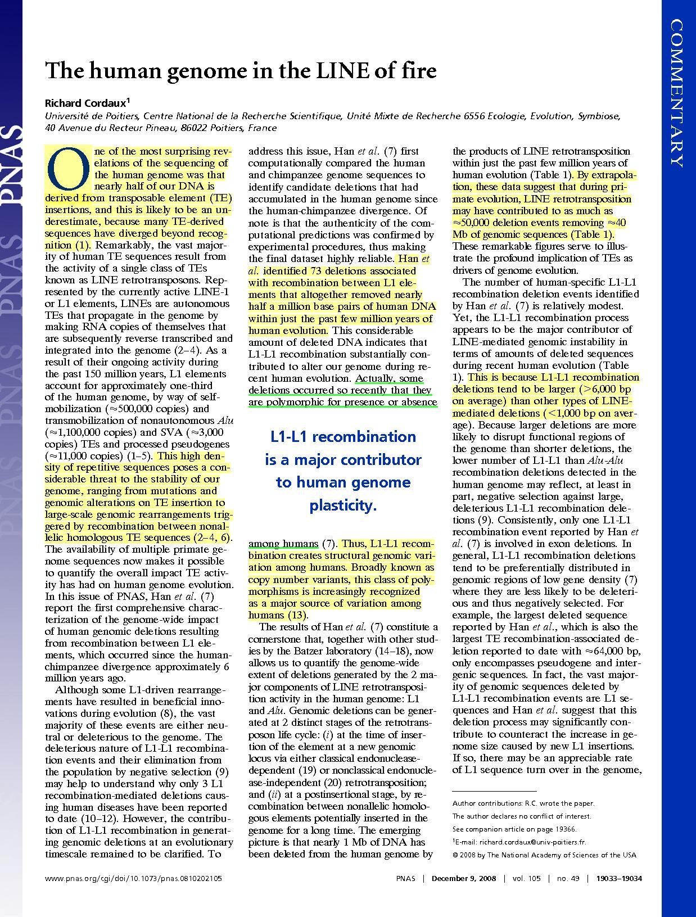
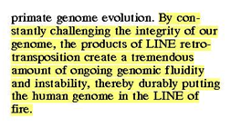

Slide 20
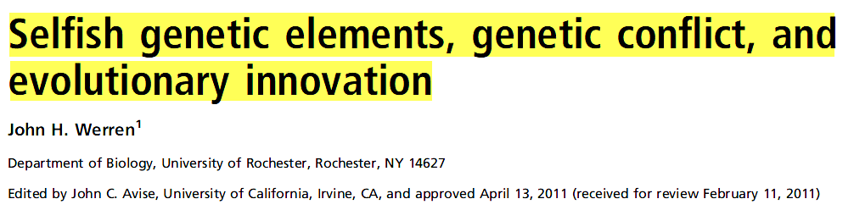
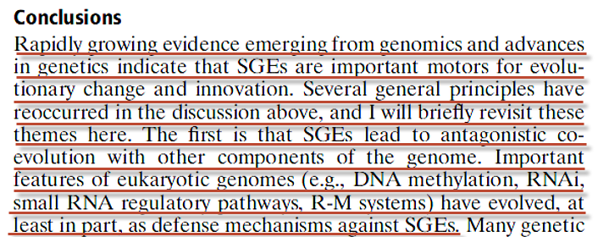
www.pnas.org/cgi/doi/10.1073/pnas.1102343108

Slide 21
And Jesus knew their thoughts, and said unto them, Every kingdom divided against itself is brought to desolation; and every city or house divided against itself shall not stand:
(Mat 12:25)

Slide 22

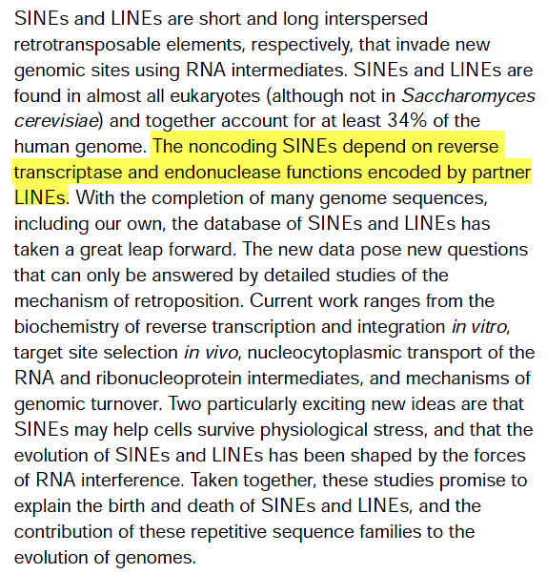
Current Opinion in Cell Biology 2002, 14:343–350

Slide 23
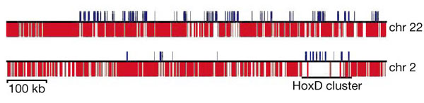
Density of TEs in the human euchromatin
TEs
exons of known genes
TE and exon density in two regions of human chromosomes 2 and 22.
From Figure 21, IHGSP, Nature 409: 860-927 (2001) Venter, Craig

Slide 24
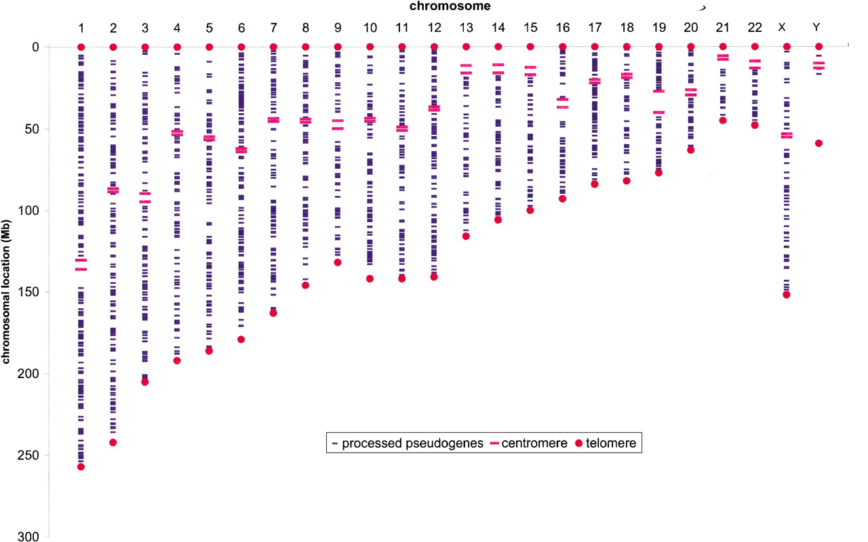

The human RP processed pseudogene population
Zhang Z et al. Genome Res. 2002;12:1466-1482
©2002 by Cold Spring Harbor Laboratory Press
Notes:
The human RP processed pseudogene population. Twenty-four human chromosomes are shown vertically from left to right. Pseudogenes are represented as short blue horizontal bars; long thick red horizontal bars delimit centromere region. Red dots represent chromosome ends.

Slide 25
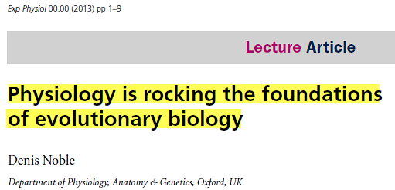
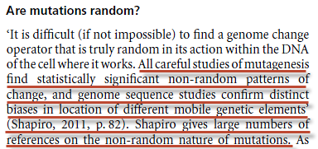
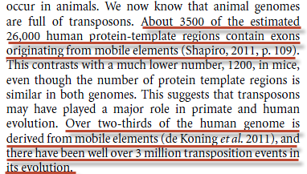

Slide 26
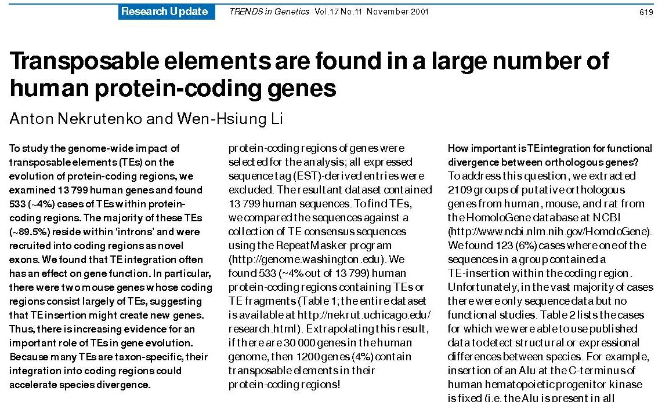

Slide 27
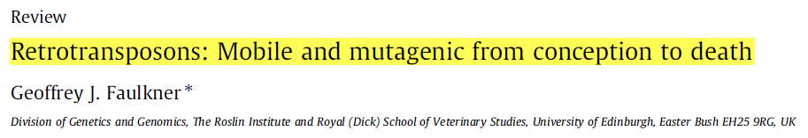
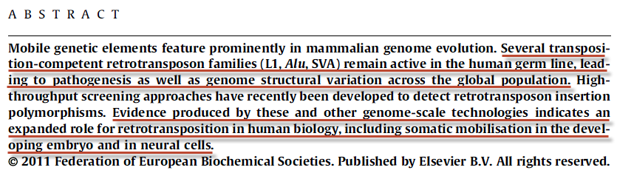
FEBS Letters 585 (2011) 1589–1594

Slide 28
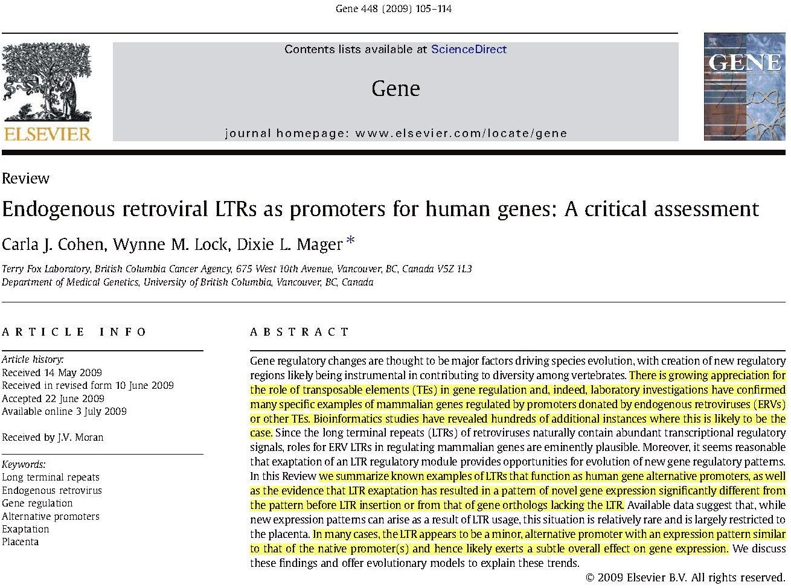
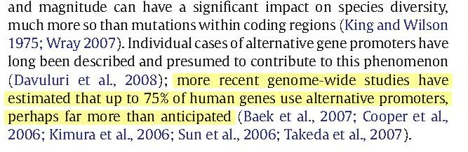

Slide 29
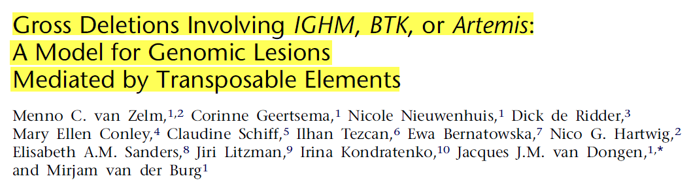
The American Journal of Human Genetics 82, 320–332, February 2008

Slide 30
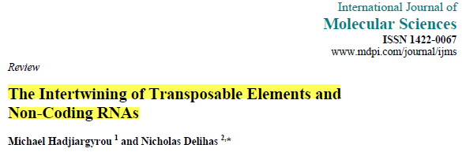
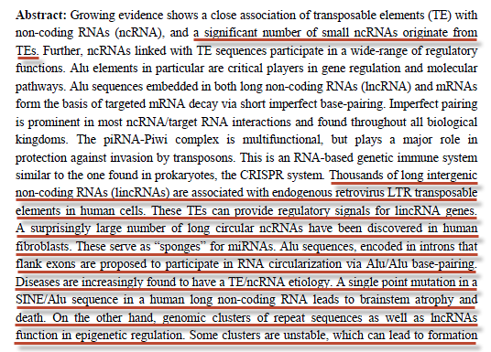
Int. J. Mol. Sci. 2013, 14

Slide 31
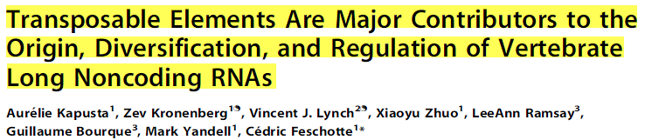
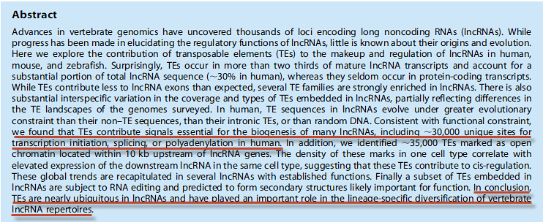
PLOS Genetics 1 April 2013 | Volume 9 | Issue 4

Slide 32
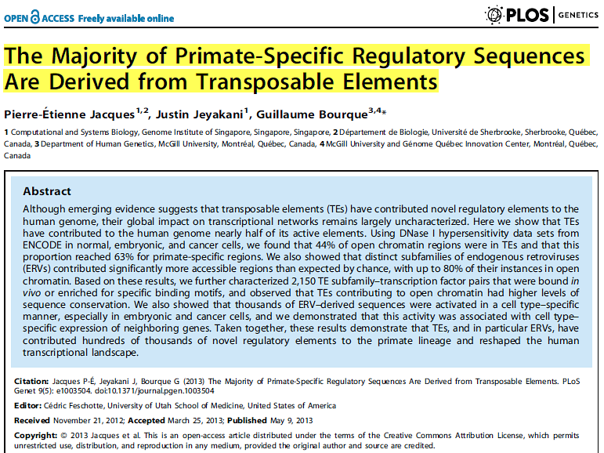
PLOS Genetics | May 2013 | Volume 9 | Issue 5

Slide 33
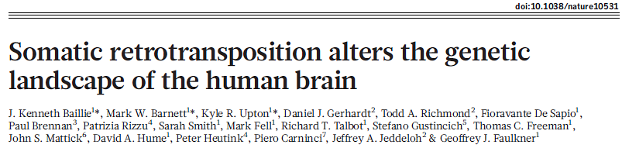
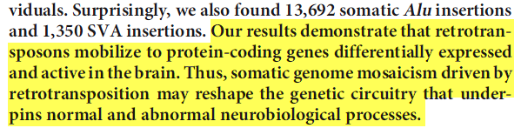
5 3 4 | N AT U R E | VO L 4 7 9 | 2 4 N O V E M B E R 2 0 1 1

Slide 34
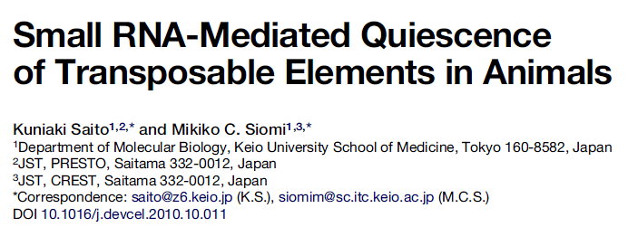
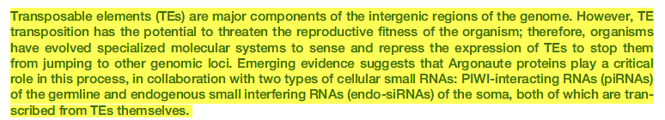
The Cell Fights Back
Developmental Cell 19, November 16, 2010

Slide 35
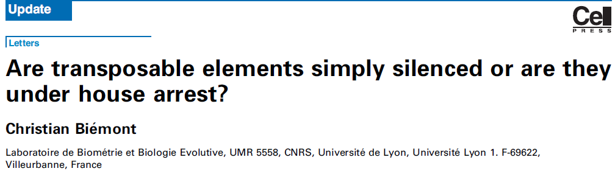
Trends in Genetics Vol.25 No.8 2009

Slide 36
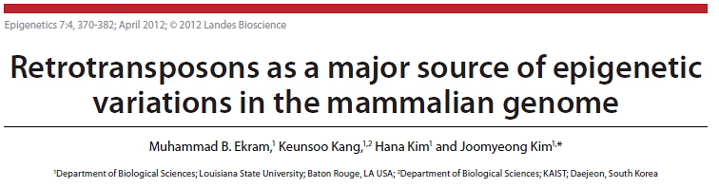

Slide 37
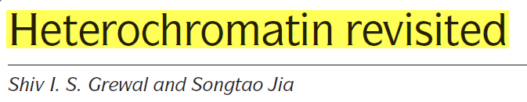
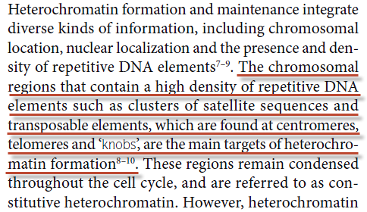
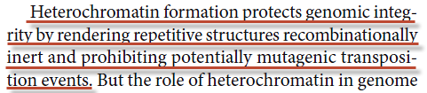
NATURE REVIEWS | GENETICS VOLUME 8 | JANUARY 2007

Slide 38
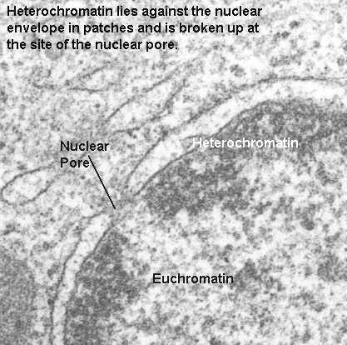
Heterochromatin

Slide 39
My transgression is sealed up in a bag, and thou sewest up mine iniquity.
(Job 14:17 KJV)
The iniquity of Ephraim is bound up; his sin is hid.
(Hos 13:12)

Slide 40
He that is not with me is against me: and he that gathereth not with me scattereth.
(Luke 11:23)

Slide 41
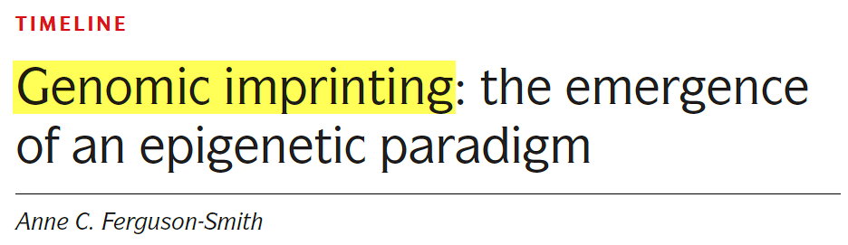
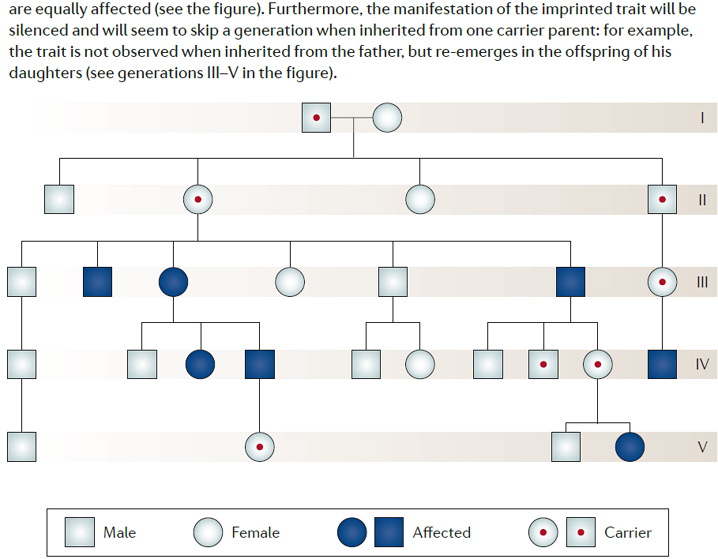
NATURE REVIEWS | GENETICS
VOLUME 12 | AUGUST 2011 | 569

Slide 42
Keeping mercy for thousands, forgiving iniquity and transgression and sin, and that will by no means clear the guilty; visiting the iniquity of the fathers upon the children, and upon the children's children, unto the third and to the fourth generation.
(Exodus 34:7)

Slide 43
VIRUSES
The Mutated Sons of TE’s

Slide 44
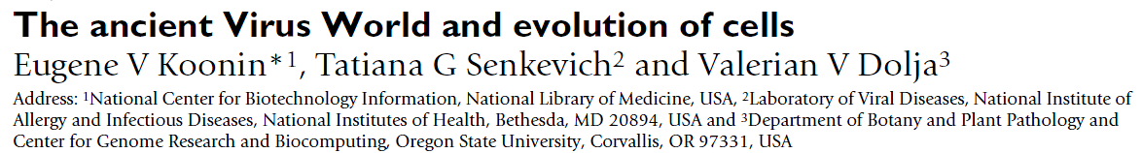
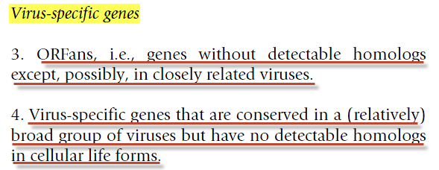
Biology Direct 2006, 1:29

Slide 45
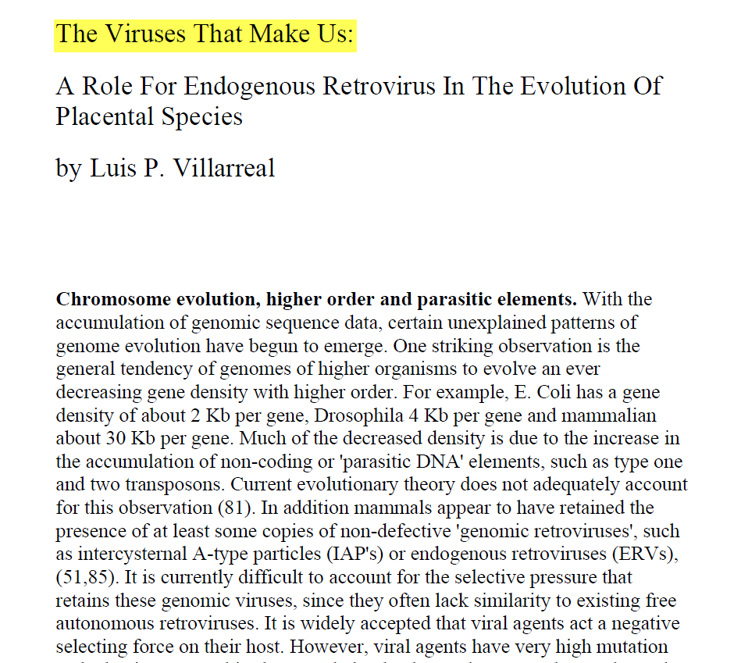

Slide 46
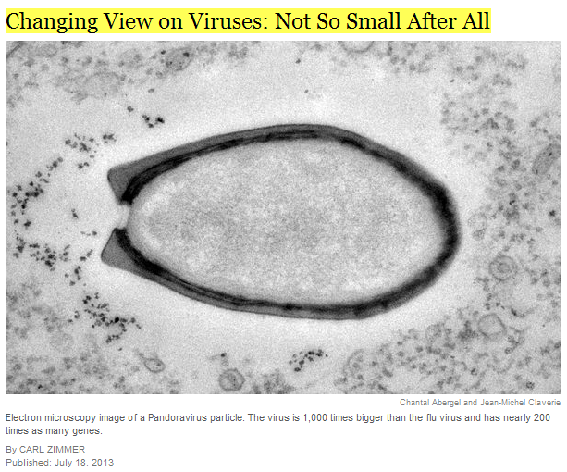

Slide 47

New Scientist 30 January 2010

Slide 48


TOXIN/ANTITOXIN MODULE
© Springer Science+Business Media Dordrecht 2012

Slide 49
They that see thee shall narrowly look upon thee, and consider thee, saying, Is this the man that made the earth to tremble, that did shake kingdoms; That made the world as a wilderness, and destroyed the cities thereof; that opened not the house of his prisoners?
(Isa 14:16-17)
The Spirit of the Lord GOD is upon me; because the LORD hath anointed me to preach good tidings unto the meek; he hath sent me to bind up the brokenhearted, to proclaim liberty to the captives, and the opening of the prison to them that are bound; (Isa 61:1)

Slide 50

Current Opinion in Virology 2013, :1–11

Slide 51
Why, as by one man sin entered into the world, and death by sin; and so death passed on all men, for that all have sinned:
(Romans 5:12 AKJV)
Nevertheless death reigned from Adam to Moses, even over them that had not sinned after the similitude of Adam's transgression, who is the figure of him that was to come.
(Romans 5:14 AKJV)

Slide 52
Genetic Engineering

Slide 53


Nature Methods | VOL. 6 NO. 6 | JUNE 2009 | 415

Slide 54
How do TE’s affect the host genome?
They “hijack” it in a number of ways:
      Makes duplicate copies of some genes.
      Stop or start certain genes’ transcription.
      Initiate “Nonsense” transcription.
      Cause breakage’s in chromosomes.
      Move genes and non-coding base pairs to other areas of the genome, and /or cause them to be deleted altogether.
      “Flip genes”, insert themselves into genes, etc. (Pseudogenes).
      Hijack control of the genes

Slide 55

Cell. Mol. Life Sci. (2009) 66:3727–3742

Slide 56
What is the result of TE’s on the genome?
Aging
Death
Cancer
Genetic Diseases
Autoimmune Diseases
Endocrine Diseases
Mental Illness
“Selfish” behavior

Slide 57
Another parable He put forth to them, saying: "The kingdom of heaven is like a man who sowed good seed in his field; but while men slept, his enemy came and sowed tares among the wheat and went his way. But when the grain had sprouted and produced a crop, then the tares also appeared. So the servants of the owner came and said to him, 'Sir, did you not sow good seed in your field? How then does it have tares?' He said to them, 'An enemy has done this.' The servants said to him, 'Do you want us then to go and gather them up?'
(Mat 13:24-28)

Slide 58
But he said, No; lest while you gather up the tares, you root up also the wheat with them.
Let both grow together until the harvest: and in the time of harvest I will say to the reapers, Gather you together first the tares, and bind them in bundles to burn them: but gather the wheat into my barn.
(Matthew 13:29-30 AKJV)

